Slide 1
FIND BEST LOCATION FOR NEW OFFICE
Created by
Miraalfasa Sharma

Slide 2
INTRODUCTION
These days IT Services are much in demand, more and more new start-up companies arise. Most of the IT Service Companies in the Asia targets USA as Development Cost of Asian Companies are less than the US. Moreover, USA Business Persons are interested in getting IT Service done remotely at cheaper rates but as there are might Point of Contacts or Office in USA for support, sometimes they avoid dealing with which is ultimately loss to the Sales of IT Service. To increase their sales by having a new marketing office in USA we need to select the best place for their office where more people are exposed to the office and marketing team can get the potential targeted audience.

Slide 3
PROBLEM
As we are looking for a perfect potential location in the USA, we need to know the high density areas where people spend more and where they spend more, so that, the people can marketing office and marketing team can contact them for the lead generation and can have a good sales conversion.
So, to increase the ultimate lead generation and sales it is required to analyze the best place to start a Marketing Office.

Slide 4
INTEREST
The CEO of IT Company is interested in starting a new marketing office in the best locality of all the cities in United states. According to him, following constraints defines a best locality.
Population density of a locality
Per Capita income
Population of each location
Venues in each locality
The category of the venues that he's interested in are,
Shops & Service
Professional & Other places

Slide 5
DATA
To find the best location for marketing office, we need to get the data from the following sources:
List of all the cities in United States with population density and coordinates: https://en.wikipedia.org/wiki/List_of_United_States_cities_by_population
List of all the cities in United States with Per Capita Income: https://en.wikipedia.org/wiki/List_of_United_States_counties_by_per_capita_income
Using FourSquare API to get the following:
List of all venues in each city.
List of all venues in each locality in the selected city.

Slide 6
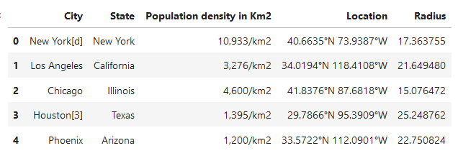
DATA AFTER CLEANING FOR POPULATION DENSITY

Slide 7
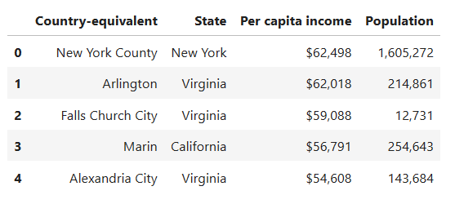
DATA AFTER CLEANING FOR PER CAPITA INCOME

Slide 8
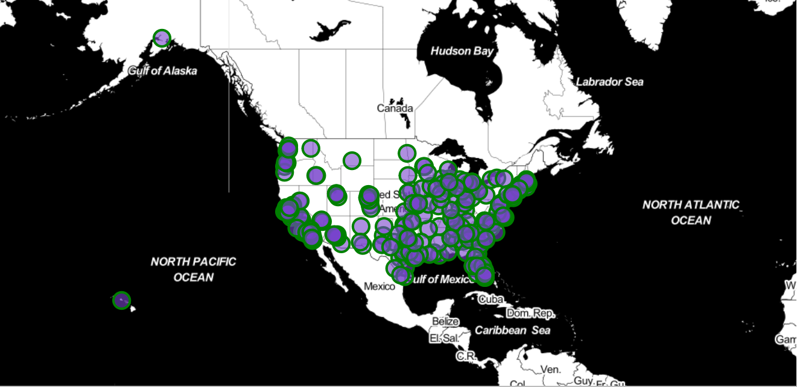
VIEW NEIGHBOURS ON MAP

Slide 9
1.
Get Data from Wiki
2.
Get data from FourSquare API
3.
Remove Unwanted Properties
4.
Prioritize Venue Category
5.
Normalize data using MinMaxScaler
6.
Get Best City & State
7.
Get Lat, Lng of Best City
8.
Find Best Venues in the city
9.
Prioritize Venue Category
10.
K-Means algorithm to cluster venues
11.
Group the list by cluster mean.
12.
Get lat, lng with the mean weight
13.
Plot the final map

Slide 10
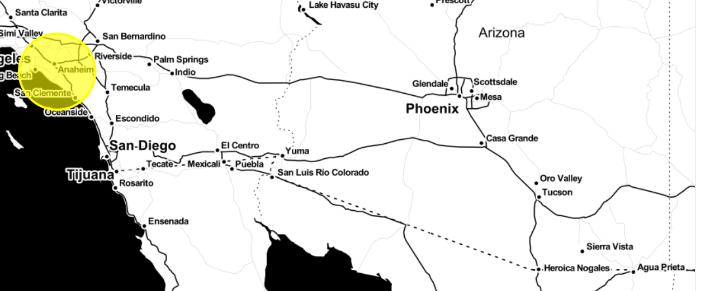
RESULT
Based on the given constraints, a new marketing office should be in a place closer to the center of the circle to attract a greater number of diverse and potential customers to get huge revenue.

Slide 11
Thank You

